Slide 1
Pub/Sub Middleware for WSN
- System Design

Slide 2
Last Week…
Background
  WSN
  middleware for WSN
  macroprogramming for WSN.
Motivation
Related Works
Possible Contributions

Slide 3
System Model
N number of sensor nodes as publisher
One sink node as subscriber
An event description language is provided to the application programmers to develop applications
The program written by application programmers will be compiled into the codes in an intermediate language
The compiled codes will be disseminated to the network

Slide 4
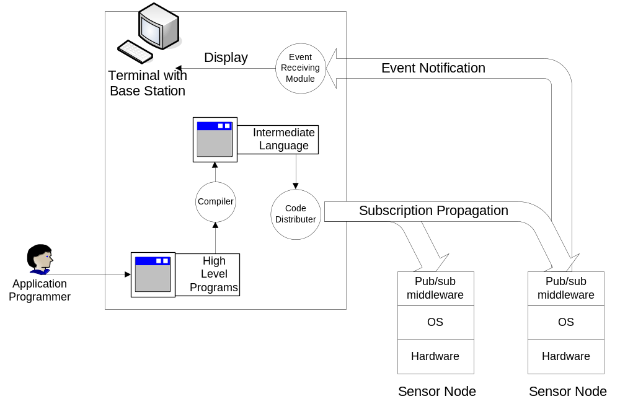
System Architecture

Slide 5
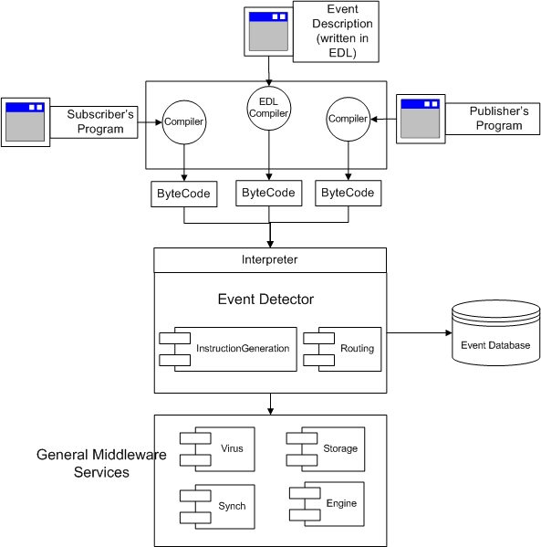
Software Architecture

Slide 6
Software Architecture
Application Programmers
  Event Description Language
  Subscriber’s language
  Publisher’s language
System Programmers
  Low-level middleware level APIs

Slide 7
Event Description Language
Primitive Events
  Event Attributes
  Built-in System Attributes
Composite Events
  Event Methods
  Some special primitives to handle event based processing
Subscription Statement

Slide 8
Primitive Events
Events are expressed as a set of ‘attribute-value’ pairs:
  Event BasicEvent {
  Time time;
  int id;
  int duration;}
Besides the attributes related to sensors, there are some attributes provided by the system (built-in attributes):
  Time (the timestamp)
  Rate (the rate of the generation of an event)
  ID (the ID of the sensor node)
  Duration (the duration of each event)
Built-in attributes are included in the ‘BaseEvent’. User created events will automatically inherit ‘BaseEvent’ and have these attributes.

Slide 9
Composite Events
Event LightSeqEvent {
uint8_t minX;
uint8_t maxX;
bool detected;
public LightSeqEvent (uint8_t x1, uint8_t x2) {
this.minX = x1;
this.maxX = x2;
detected = false;
}
bool occurred () {
LightEvent previous;
walkthrough {
LightEvent e= new LightEvent (400);
if (e.locationX==minX && e.occurred()) {
detected = true;
previous = e;
}
else if (e.locationX==0 && !e.occurred())
detected = false;
if (detected) {
if (e.time==previous.time+1 && e.locationX==previous.locationX+1
&& e.occurred()) {
previous=e;
if (e.locationX==maxX)
return true;
}
else if (e.time==previous.time+1 && e.llocationX==previous.locationX+1
&& !e.occurred()) {
detected=false;
}
}
}
}
}

Slide 10
Event Methods
Constructors: initialization
‘occurred()’ method: indicate the occurrence of an event
Event LightEvent {
Time time;
uint16_t light;
uint16_t threshold;
int id;
int duration;
int locationX;
int locationY;
public LightEvent (uint16_t threshold) {
this.threshold=threshold;
}
public bool occurred () {
if (light> threshold)
return true;
else
return false;
}
}

Slide 11
‘walkthrough’ Primitive
‘LightSeqEvent’ detects a sequence of light events.
We introduce a new notation ‘walkthrough’ here. The code block of ‘walkthrough’ is executed on each sensor nodes in the network for exactly once.
Events are ‘collected’ from each sensor nodes by calling “LightEvent e= new LightEvent (400);”

Slide 12
Event Subscription
To subscribe events, users simply need to construct an array of interested events and call ‘sub()’ function to subscribe.
1: sub (Event eventlist []);

